Slide 1
H1N1 Vaccine Prediction
By: Andrew Nyakiba
DATE: 21/03/2026

Slide 2
Overview
Objectives
Predict vaccination behavior.
Identify its key influencing factors.

Slide 3
Business Problem
Public health organizations need better ways to identify individuals who are likely or unlikely to get vaccinated.
Public health organizations need better ways to target individuals who are likely or unlikely to get vaccinated.

Slide 4
Data Overview
Dataset Details:
Number of records: 26,707
Number of columns: 38
Target Variable: h1n1_vaccine (Vaccinated vs not Vaccinated)
The dataset is imbalanced, with fewer vaccinated individuals.
Dataset contains demographic and behavioral data

Slide 5
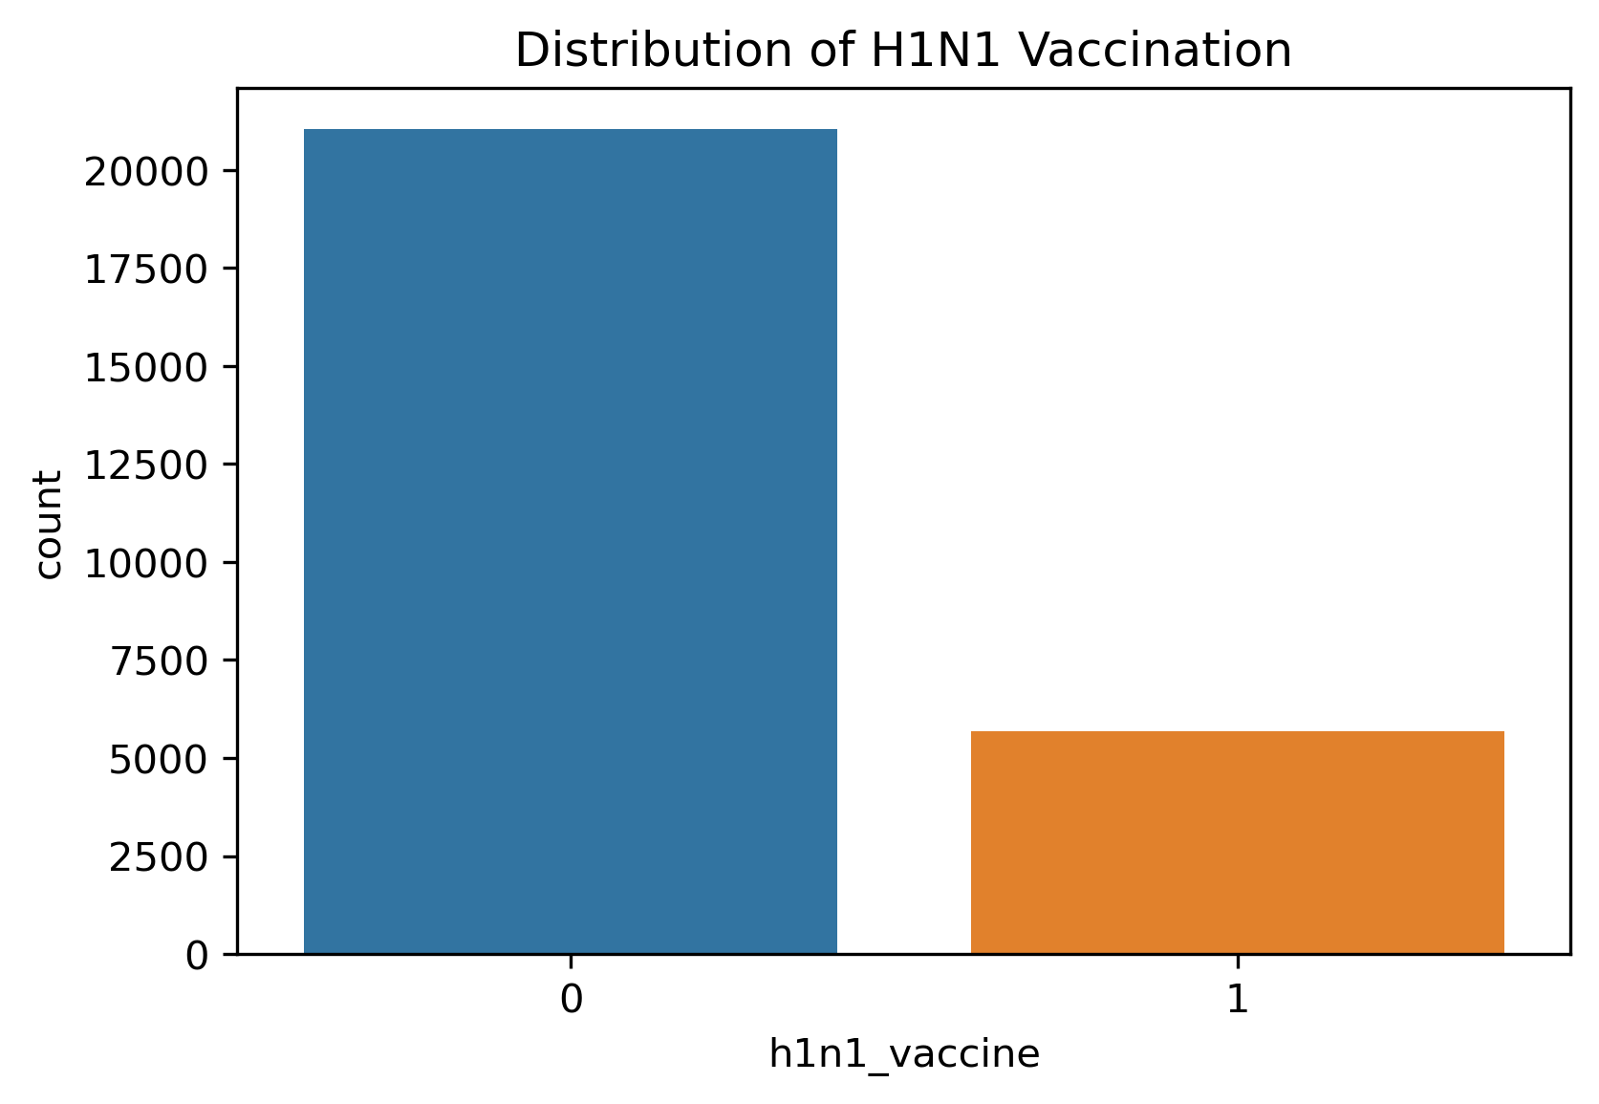
The visualization displays how the data is imbalanced.

Slide 6
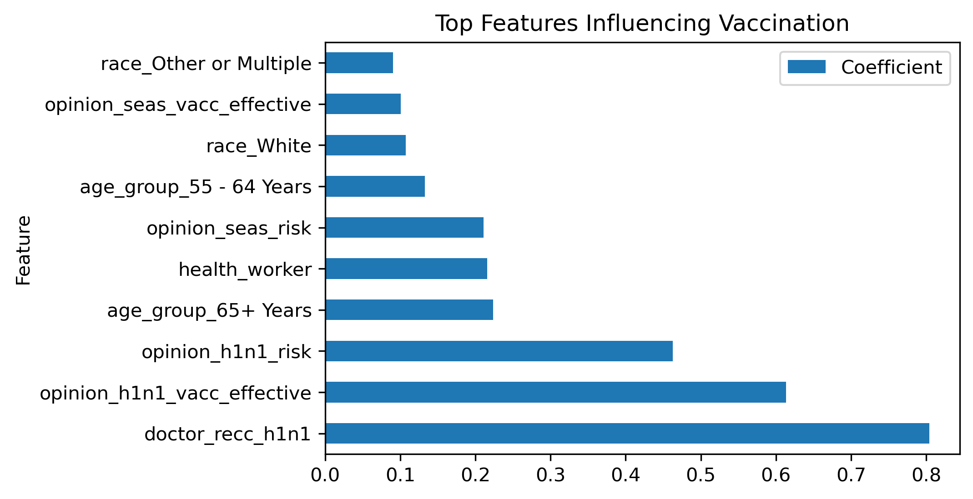
Key Influencing Features
Both behavioral and perception-based factors strongly influence vaccination decisions.

Slide 7
Modelling approach
We used multiple models and improved them iteratively.
The models used involve:
A logistic regression (Baseline Model)
A decision tree model
A balanced logistic regression
A balanced decision tree model

Slide 8
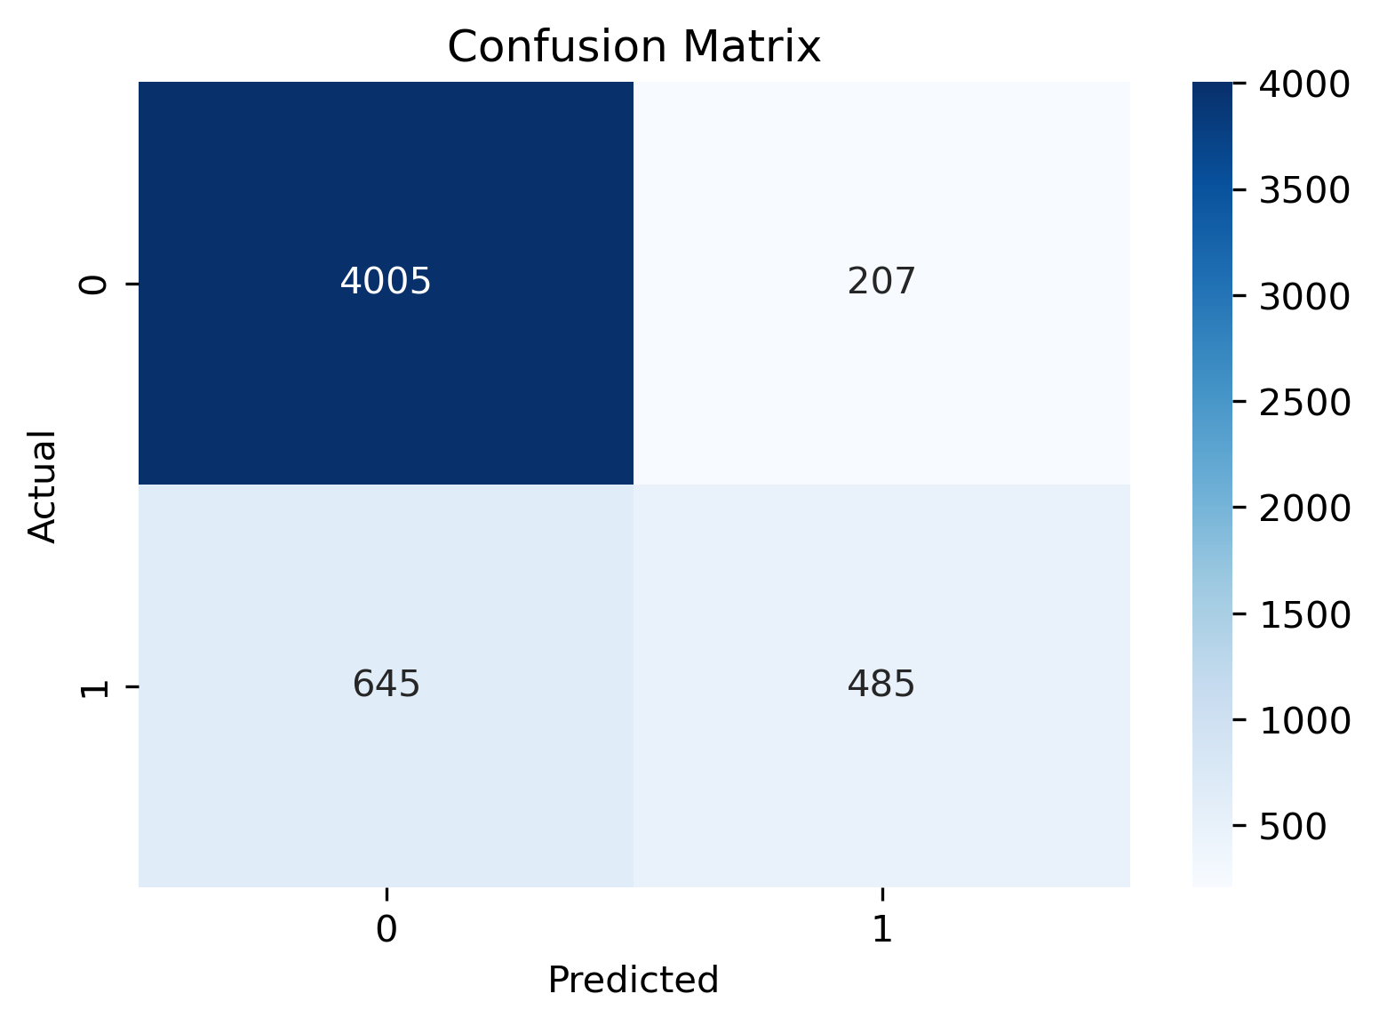
Baseline Model Performance
The model performed well overall but struggled to identify vaccinated individuals.
The model had an accuracy of 84%.

Slide 9
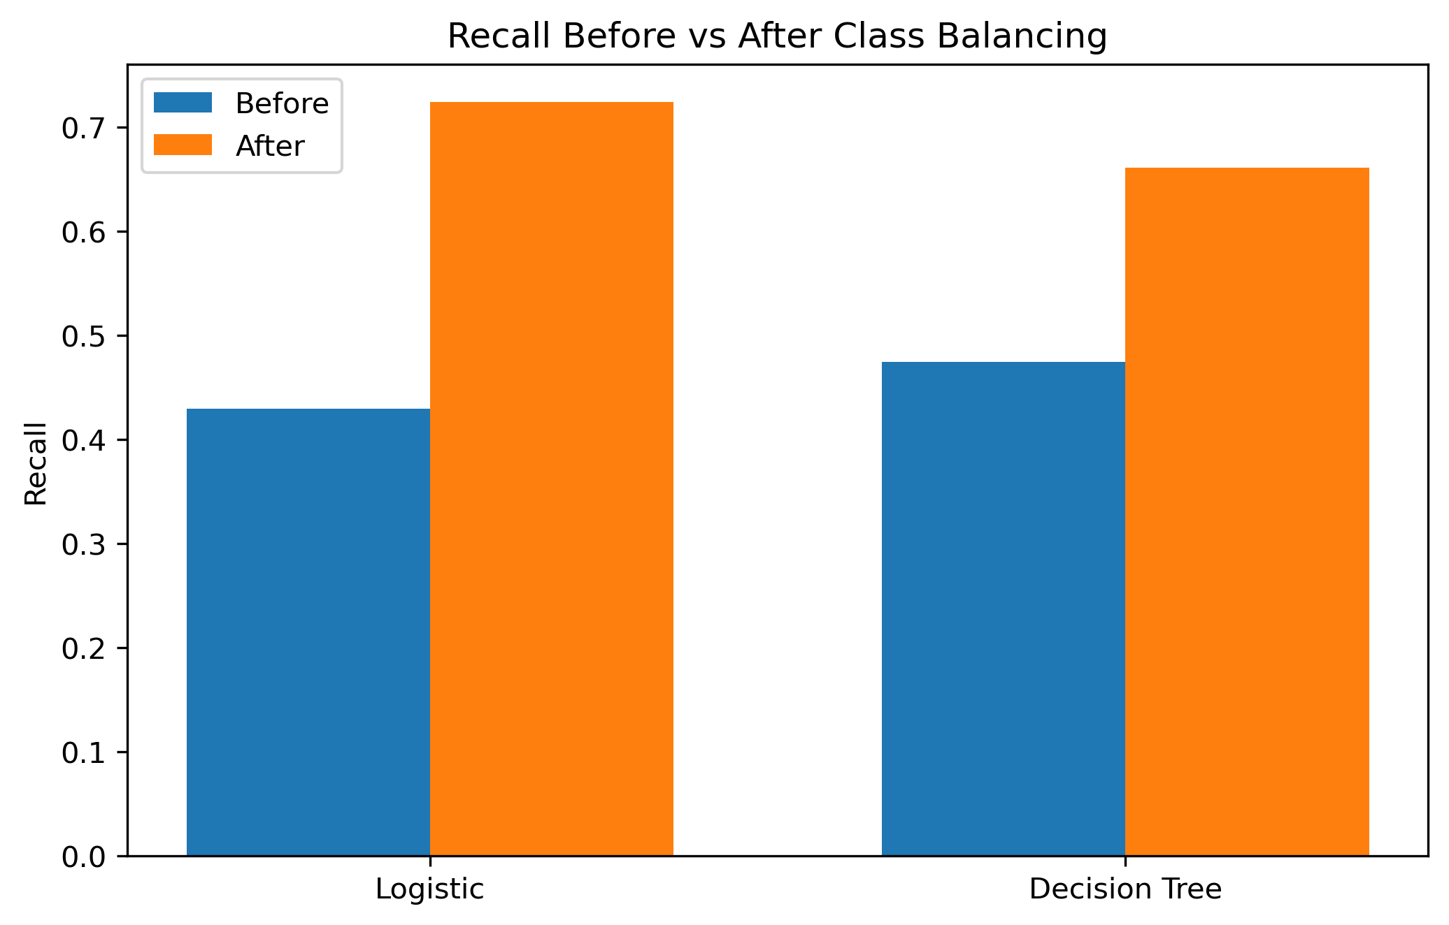
Improving the Model
Due to the imbalance noticed in the data, class weighing was applied to dissipate the issue
Handling class imbalance significantly improved performance of both models.
The Logistic Regression showed greater improvement of 30%.

Slide 10
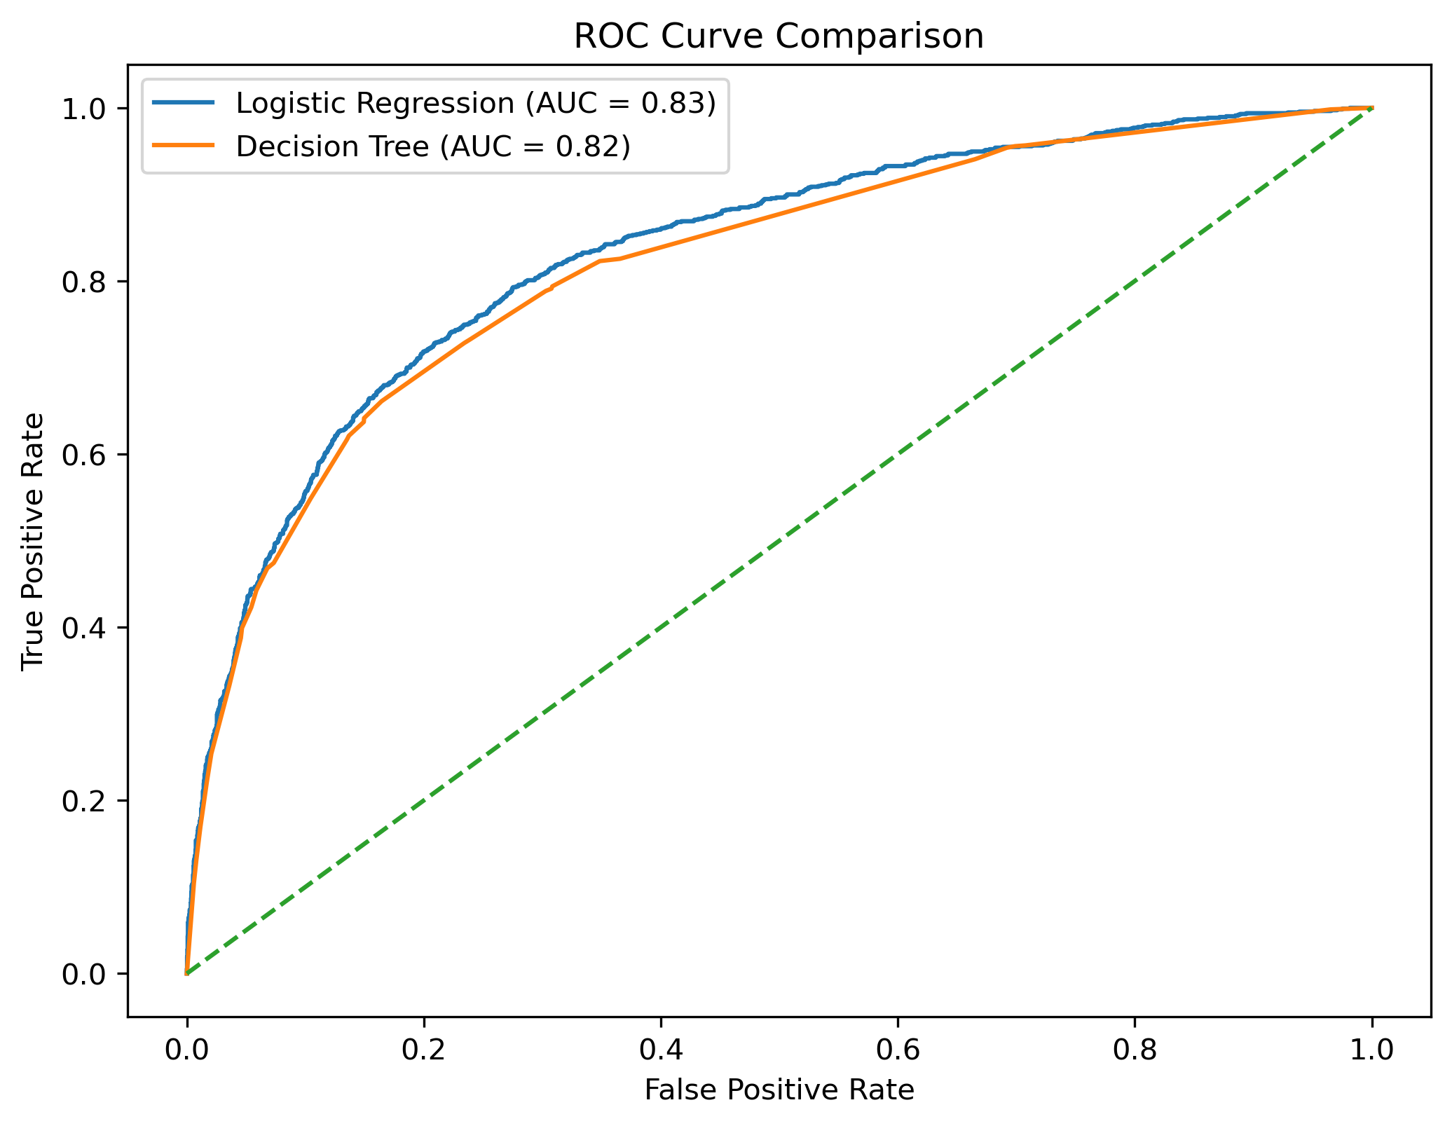
Model Comparison
The Logistic Regression achieved a higher AUC (Area Under Curve) thus showing better overall classification ability.

Slide 11
Final Model Selection
Balanced Logistic Regression
The model showed the highest improvement in recall (about 30% increase).
The model is better at detecting the minority class.
The model has a higher AUC.
The model handles imbalance well.
The model is more interpretable and best at identifying the vaccinated individuals.
Thus this is the best model for predicting vaccination behavior and supporting targeted interventions.

Slide 12
Recommendations
Increase doctor led vaccination campaigns.
Improve public trust in vaccines.
Target groups with lower vaccination likelihood.
Use data driven strategies to improve outreach.
Public health campaigns should focus on individuals less likely to get vaccinated.

Slide 13
Limitations
Class imbalance affected the model performance.
Data is self-reported and thus may contain bias.

Slide 14
THANK YOU!
Any Questions?

